Slide 1
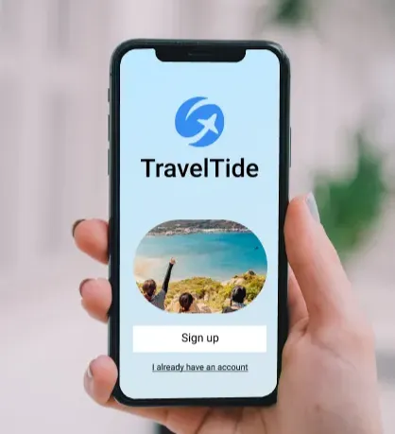
TravelTide: Customer Segmentation for Smarter Rewards
Purpose: Understand traveller behaviour to design targeted perks that grow loyalty and repeat bookings.
👤 Md Erfan 🎓 Masterschool 2025
Notes:
Welcome. My project is called TravelTide – Customer Segmentation for Smarter Rewards.
The goal was to understand traveler behavior
and
create personalized perks that increase
-> loyalty and future bookings

Slide 2
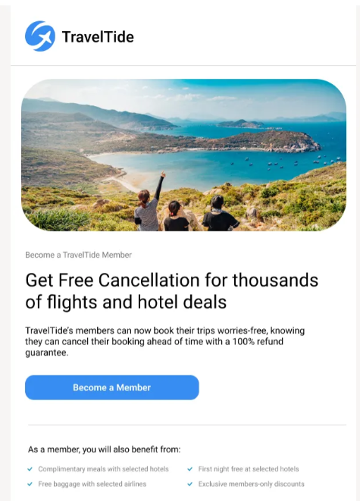
Project Overview
Turning data into personalized journeys
Raw Data
Clearing
Feature Engineering
Segmentation
Personas
Business Strategy
Notes:
TravelTide is an online travel booking platform looking to personalize its rewards program.
Our goal was to understand how different types of travellers behave — and use that insight to offer the right perks to the right people.
We combined both
-rule-based and
-machine-learning segmentation
to get a 360° customer view.

Slide 3
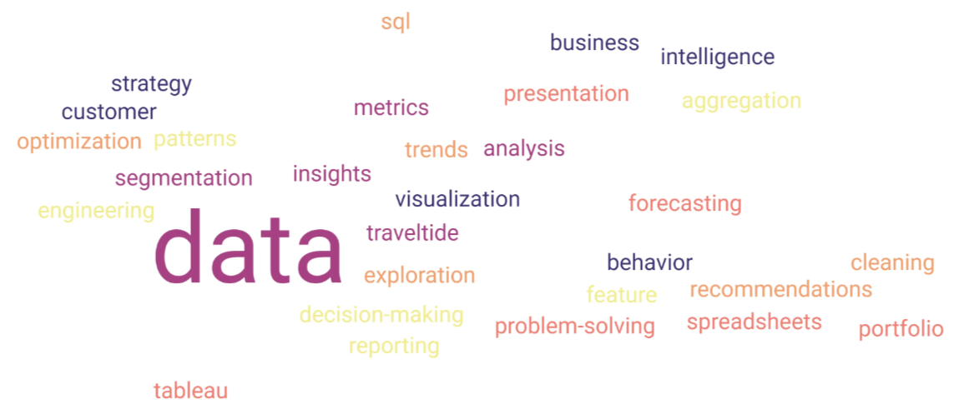
Data Preparation & Feature Engineering
Understanding the Data Behind Our Travelers
4 sources: Users · Flights · Hotels · Sessions
≈ 6 000 active users · 200 000 sessions
Key features: conversion rate, loyalty index, promo use, trip length RFM, CLTV models
➡ Gives a 360° view of traveller behaviour
Notes:
We started with nearly 6,000 users. After cleaning and merging four data sources — users, flights, hotels, and sessions —
we engineered key behavioral features such as
session frequency,
booking behavior,
conversion rate, and
promo responsiveness.
Finally, we calculated RFM and CLTV scores to measure customer value and loyalty,
which forms the foundation for both rule-based and machine learning segmentation

Slide 4
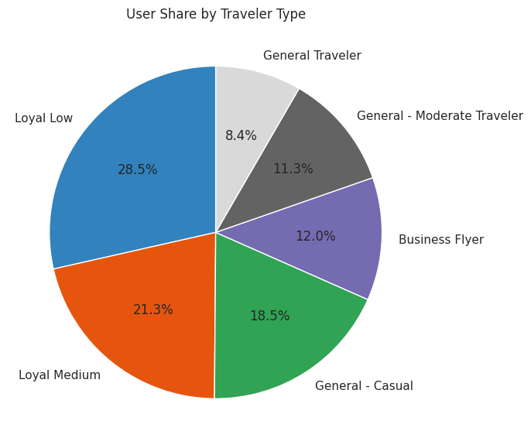
Rule-Based Segmentation
Segmentation Logic:
Used RFM + CLTV + behavior cut-offs Example rules:
Conversion > 0.6 → Loyal
Promo > 0.25 → Discount Hunter
Trip ≤ 3 days → Business Flyer
Each user assigned a persona
Notes:
Using RFM, CLTV through logical thresholds., we created rule-based personas —
--ten traveler types that reflect how users behave and spend.
For example,
--Loyal High and Family High Value travellers keep coming back,
while Discount Hunters jump on offers.

Slide 5
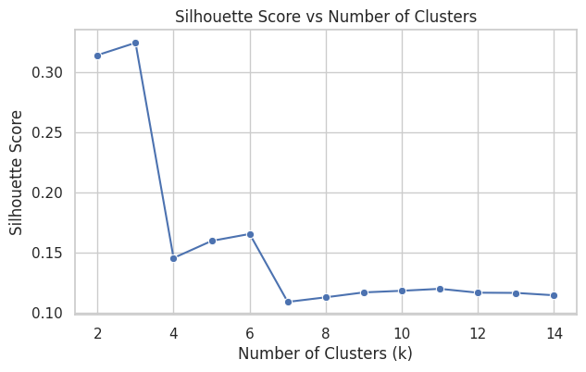
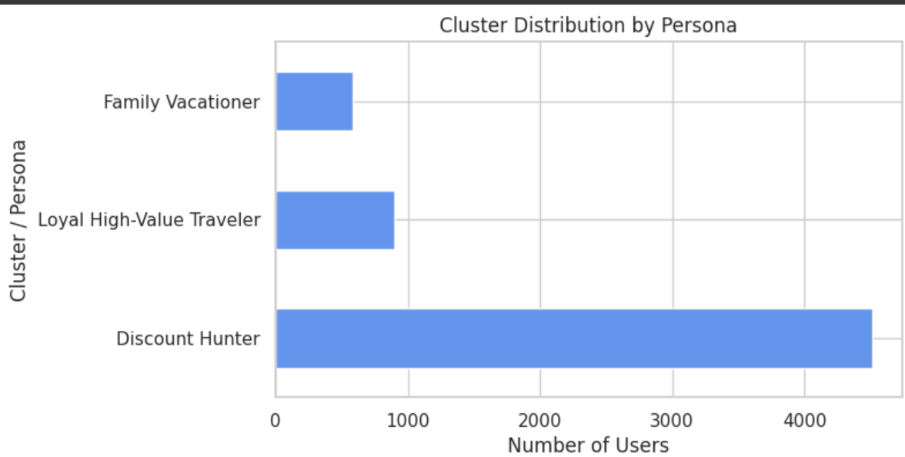
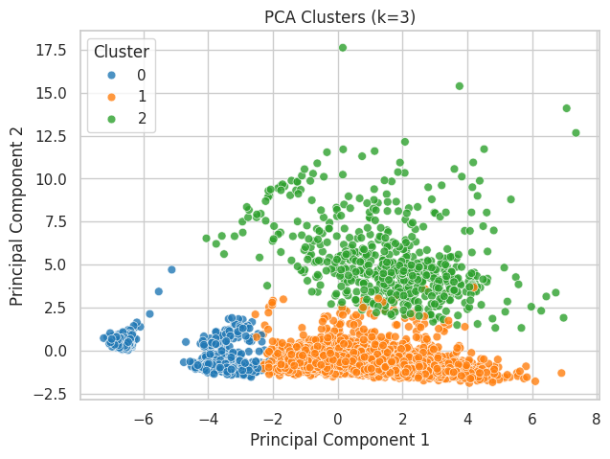
Machine Learning Segmentation
Notes:
To validate our findings, we applied PCA and K-Means clustering.
The model discovered three natural clusters: Loyal High-Value Travelers, Discount Hunters, and Family Vacationers.
“What’s interesting is that both models tell us different sides of the same story.
The rule-based model looks at customer value and loyalty
The machine learning model, on the other hand, looks at behavior and activity. It found that the most active users are actually the ‘Discount Hunters’ — people who love deals and browse often.
So, one group shows us who keeps the business stable, and the other shows us who keeps it alive and moving.
When we put these two views together, we get a complete picture of TravelTide’s customers

Slide 6
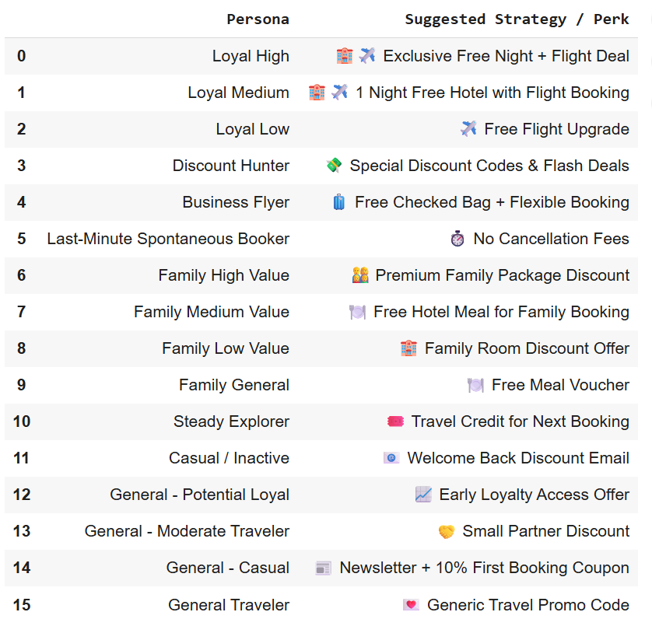
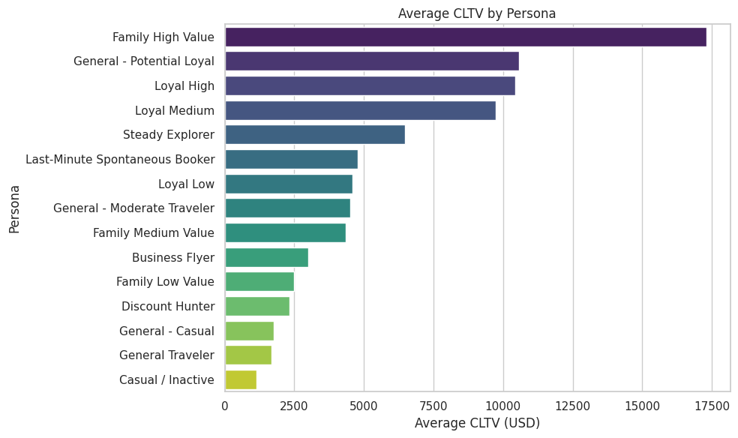
Key Insights & Business Impact
Notes:
Here’s what we found:
The Loyal High and Family High Value groups bring the biggest lifetime value — they deserve early-access upgrades and exclusive perks.
Whereas Discount Hunters react instantly to promotions — a perfect target for re-engagement offers.
What about And the Casual / Inactive users, then ? They need attention — gentle reminders, small incentives, or inspiring travel ideas to bring them back.

Slide 7
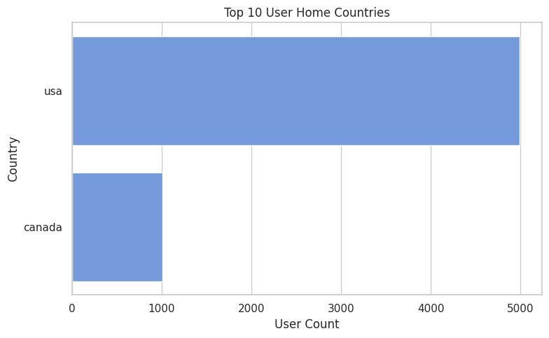
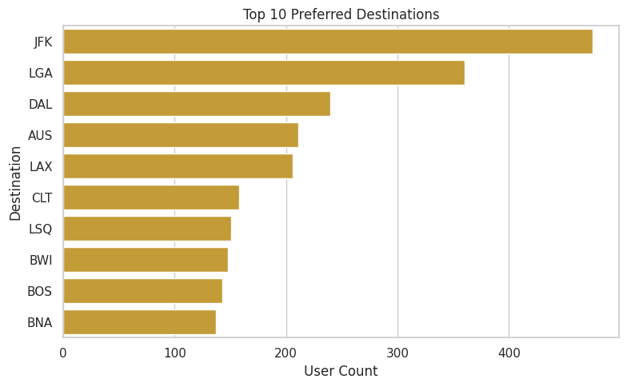
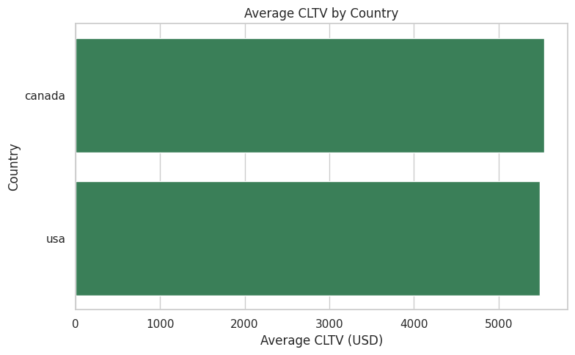
Geographic & Behavioral Insights
Notes:
We also discovered where these travelers live and where they love to go.
Most are from the US and Canada, heading toward major hubs like JFK and LAX.
even though the USA has many more users, the average CLTV for users in Canada is slightly higher based on the chart
High-value users are concentrated in these regions — giving us a clear direction for regional campaigns and partnerships.

Slide 8
Future Steps & Takeaways
Automate the RFM/CLTV pipeline
Integrate real-time segmentation
Build a dashboard to monitor key metrics continuously.
In short, this project shows how data analytics can transform TravelTide’s customer relationships into measurable business growth.
Notes:
Now that we know our travellers, the journey doesn’t end here.
Our next steps are to automate these insights Like update RFM and CLTV monthly
integrate the model into the Integrate real-time segmentation
The final goal is an interactive dashboard where marketing and product teams can see these personas live — and act instantly.

Slide 9
Relationship matters !
Not just about clusters or algorithms — it’s about relationships with customer. we can treat them not as data points, but as travelers with dreams and choices.
Thank you
Notes:
In the end, this project isn’t just about clusters or algorithms — it’s about relationships with customer. we can treat them not as data points, but as travelers with dreams and choices.

